Slide 1
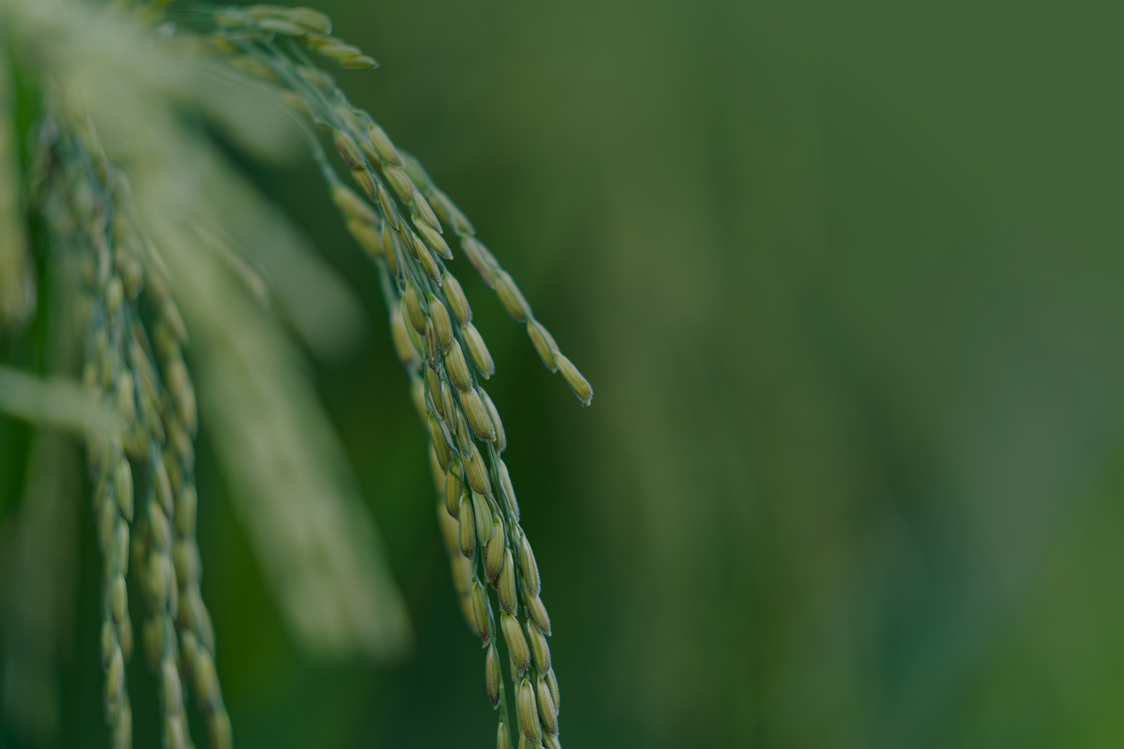





उन्नतखेती
GreenTech Innovation Hackathon:
Software for Sustainable Development
उन्नतखेती
ORAGANZIER

Slide 2


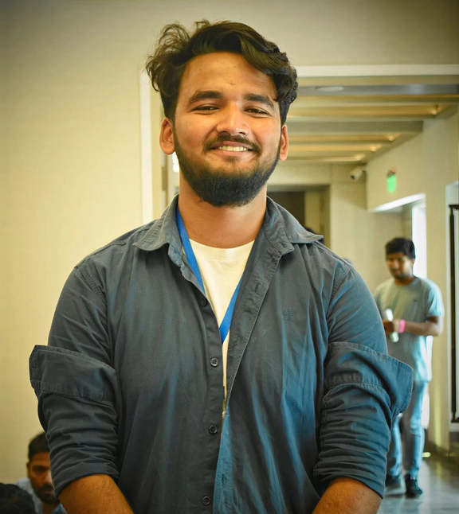

Our
Team Members
RAM KUMAR TAMANG
SUBASH SIGDEL
ABHAY KUMAR MANDAL
RANJU KAYASTHA
उन्नतखेती
Team Leader
Frontend Developer
IoT Developer
UI/UX Developer

Slide 3
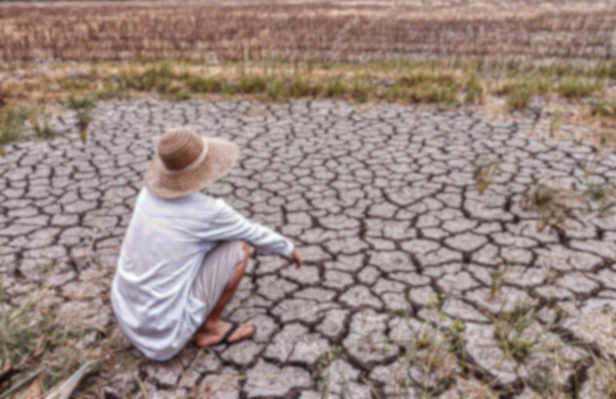
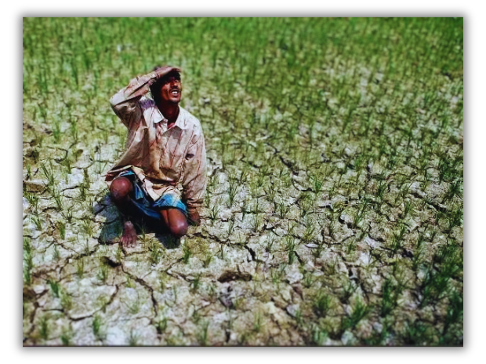
A PICTURE IS WORTH A THOUSAND WORDS
उन्नतखेती

Slide 4
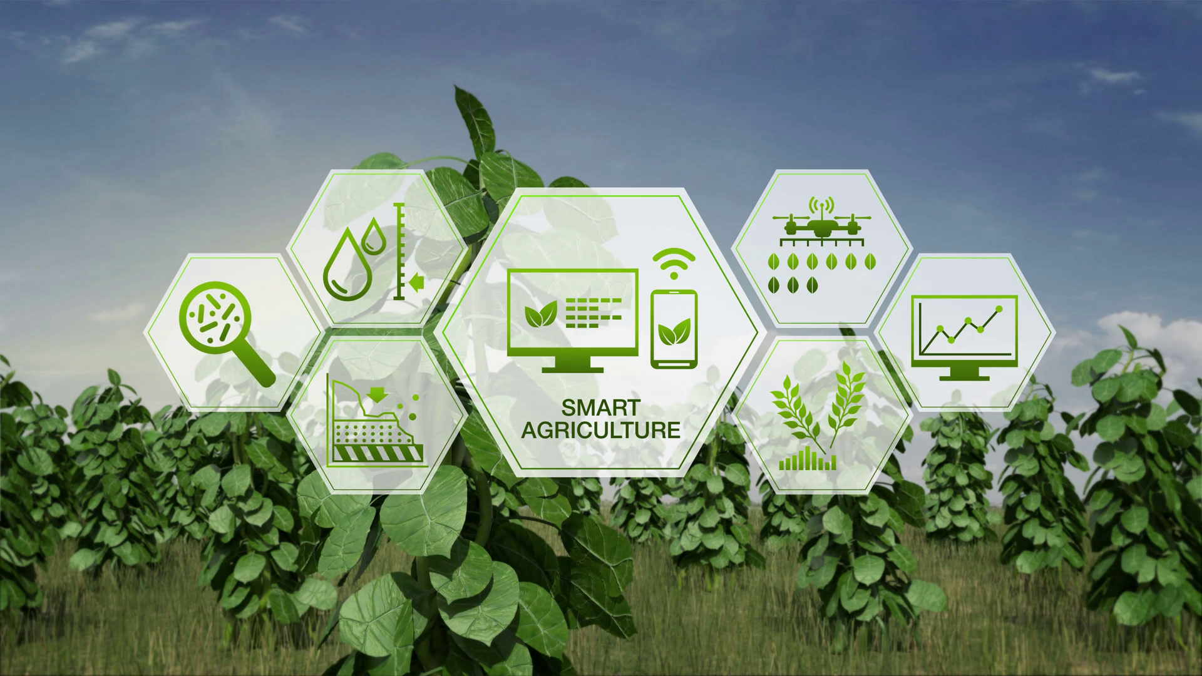
Table Of Contents
01.
02.
03.
04.
उन्नतखेती
INTRODUCTION
PROBLEMS
SOLUTION
DEMO OF SOFTWARE
What is उन्नतखेती?
Obstacles on achieving smart agricultural works.
Development of उन्नतखेती for smart agricultural work.
Elaborate on what we have developed.

Slide 5

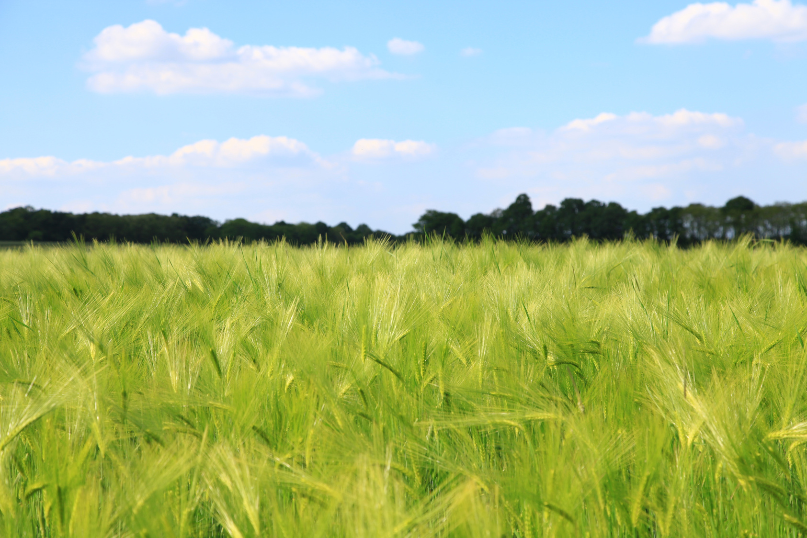

INTRODUCTION
उन्नतखेती, is a promising green technology with a focus on monitoring and managing crop and vegetable growth.
KEY OBJECTIVES:
Increase agricultural production and productivity.
Conserve, promote and utilize the environment and bio-diversity.
उन्नतखेती

Slide 6

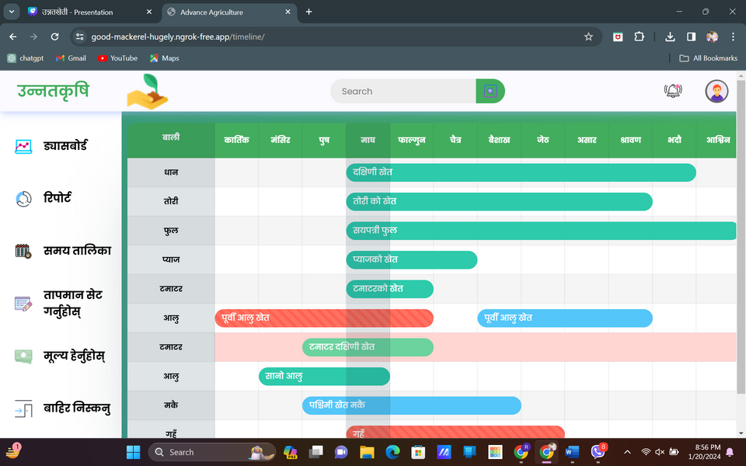
Market
Research
WATER WASTAGE
The lack of irrigation (only 28% of the total agricultural land (4.21 million ha) is irrigated (Gajmer, 2014).
VEGETATION WASTAGE
In a panel examining the food crisis in Nepal, environmental scientist Uttam Babu Shrestha said that up to 40% of vegetables are wasted daily during their transport and handling (Sitaula, 2021).
उन्नतखेती
IOT TECHNOLOGY
IoT has the most apparent growth rate in smart agriculture and smart irrigation, with five-year growth rates of 1617% and 2285%, respectively (Pang, 2023).

Slide 7
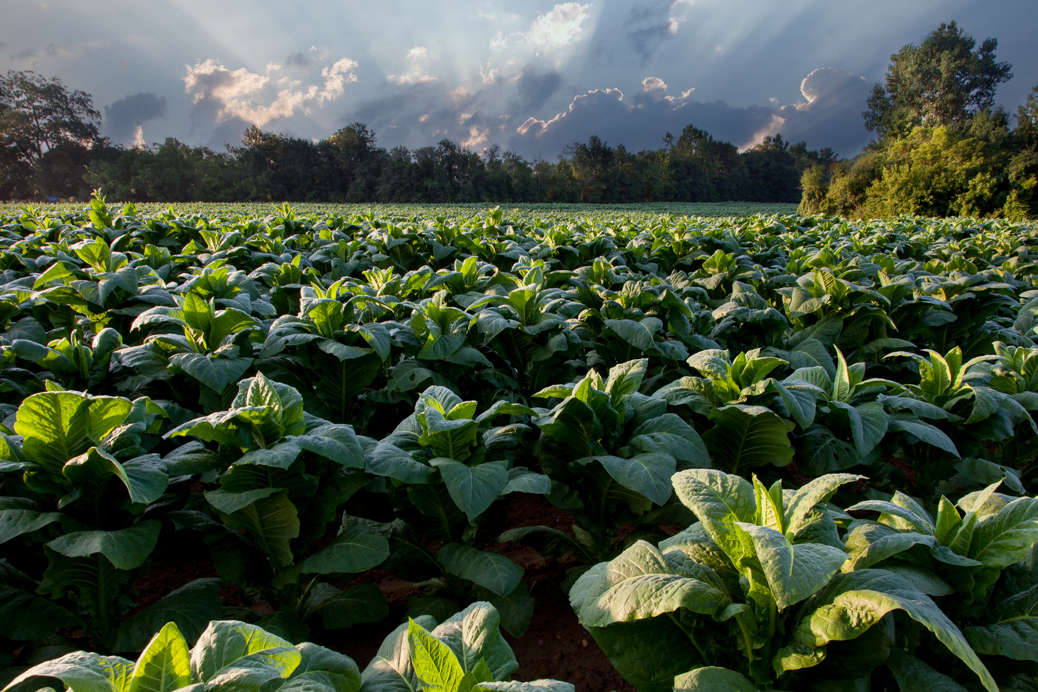
Problems:
Water Wastage
Low generative revenue
Scarcity of Food Production and consumption
Unidentified weather problems
Less importance to soil in agricultural works
Lack of real-time data monitoring
उन्नतखेती

Slide 8
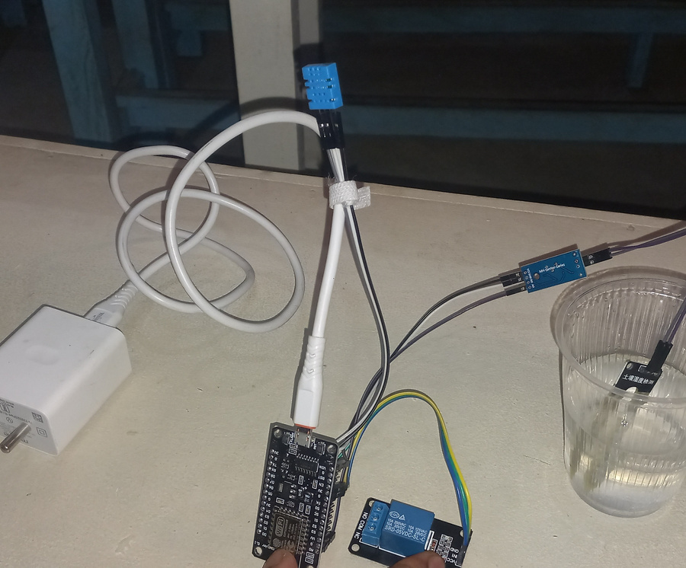
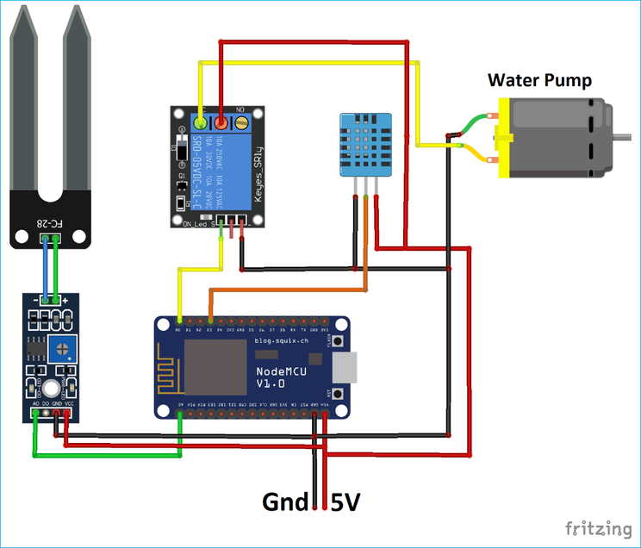
Solution: उन्नतखेती
Automation Irrigation
Increment in employment, revenue
Decrease in food importation and responsible consuming
Prediction of weather and alert the farmers
Preserve soil structure and nutrient
Plan the crop plantation and real time data monitoring
उन्नतखेती

Slide 9
Beneficieries
Farmers
Local government bodies
Consumer
Unnata Team

Slide 10
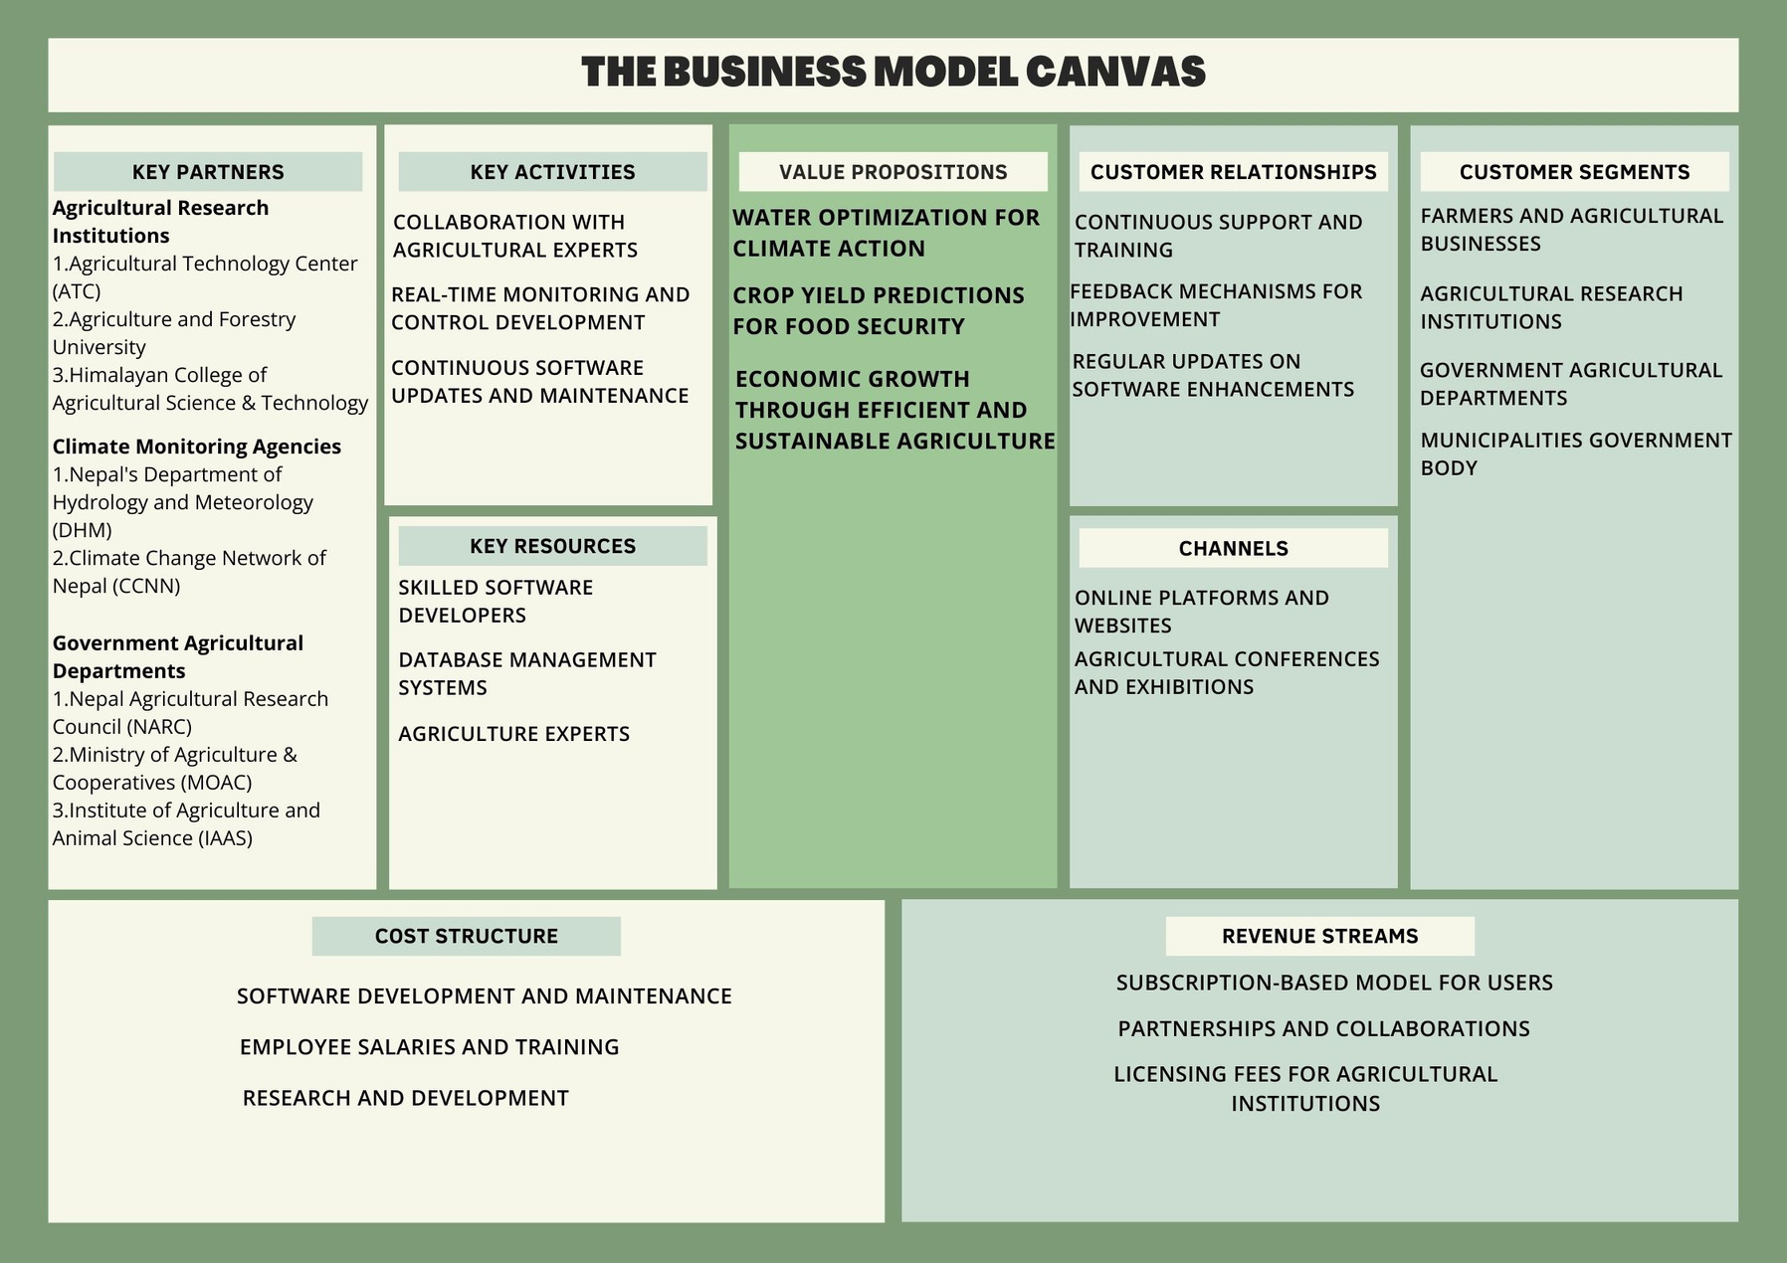
उन्नतखेती

Slide 11
Cost Estimation
38% of Koshi’s GDP in Agriculture
Main Source of livelihood for 3,721,059 which is 75% of total population of Koshi Province (4,961,412).
Our revenue model
Per Device Charge: Rs 3500
Monthly Subscription: Rs 40 per Device
Estimated Consumers: 186,052 (5% of total Farmer in Koshi Province)
Gross Monthly Revenue: RS 75,00,000
Gross Annual Revenue: Rs 9,00,00,000 (estimated for 2 Year after Launch))
Initial Capital: Rs 20,00,000
Software maintenance:2,00,000 Per Annum

Slide 12










उन्नतखेती ROLE IN SUSTAINABLE AGRICULTURE

Slide 13
REFERENCES
Dhital, R.(2004). Masters Project for the partial fulfilment of Masters degree, Yale School of Forestry and Environmental Studies. Hixon Center for Urban Ecology. https://hixon.yale.edu/sites/default/files/files/fellows/paper/dhital_raji_2003_report.pdf
Paudel, N. M.(2016). Prospects and limitations of agriculture industrialization in Nepal. Agronomy Journal of Nepal (Agron JN), Vol.4. https://www.researchgate.net/profile/Mina-Nath Paudel/publication/327704378_Prospects_and_Limitations_of_Agriculture_Industrialization_in_Nepal/links/5ba00d93299bf13e6038a884/Prospects-and-Limitations-of-Agriculture-Industrialization-in-Nepal.pdf

Slide 14
REFERENCES
Babu. C.S & Sah. P.R. (26, November, 2019). Agricultural Research and Extension System in Nepal: An Organizational Review. SpringerLink (pp 291-319). https://link.springer.com/chapter/10.1007/978-981-32-9648-0_11#citeas
Sitaula. A. (2021). Nepal’s glaring food gap. The Nepali Times. https://nepalitimes.com/news/nepal-s-glaring-food-gap

